Slide 1
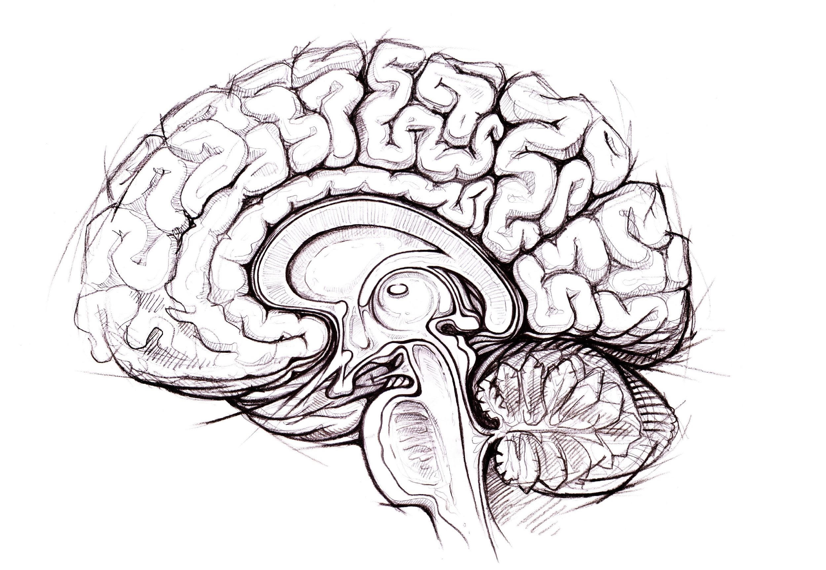
Brain Awareness Week
Bryson Reynolds
UVA Neuroscience Graduate Program
Adapted from Victoria Sanchez, PhD

Slide 2
What I’m going to be talking about today…
Overview of the brain
What brains do
Regions of the brain
Anatomy of neurons
How neurons communicate
Drugs and Addiction
Concussion and Head Impacts
AMA (about brains)

Slide 3
What does the brain do?

Slide 4
What does the brain do?
Sensation
Perception
Create Plans
Create Desire
Control Desire
Create Emotions
Control Emotions
Body movement
Body Position
Create Memories
Empathize
Manage Organs
Imagine
+ Many More

Slide 5
What are some areas of the brain?

Slide 6
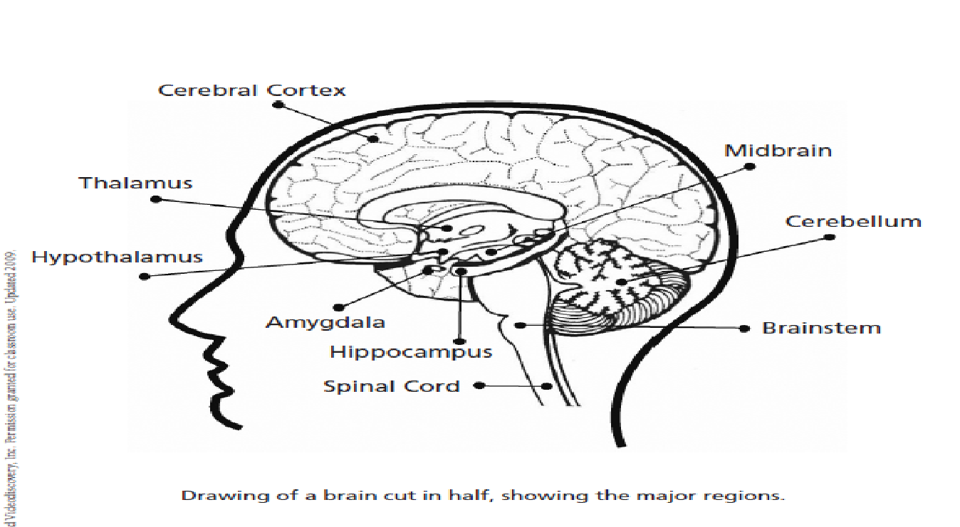
Human brain – major regions

Slide 7
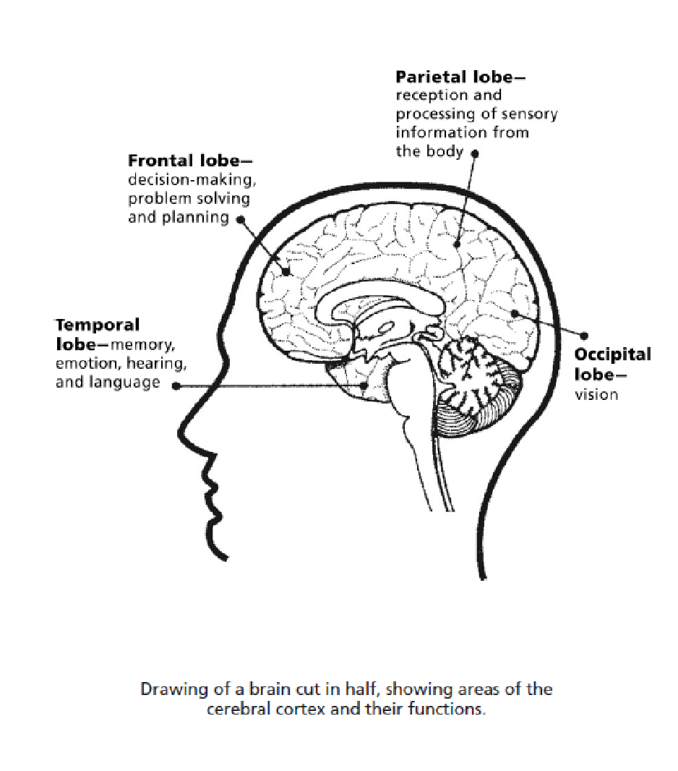
Human brain - lobes

Slide 8
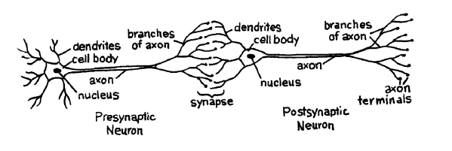
The brain is made up of a specialized cell type called…
Neurons
100 billion neurons make up the brain
Communicate with each other using chemical messages at synapses

Slide 9
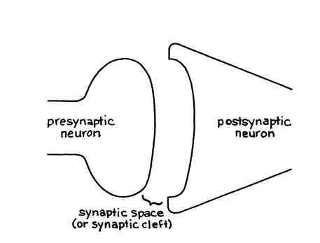
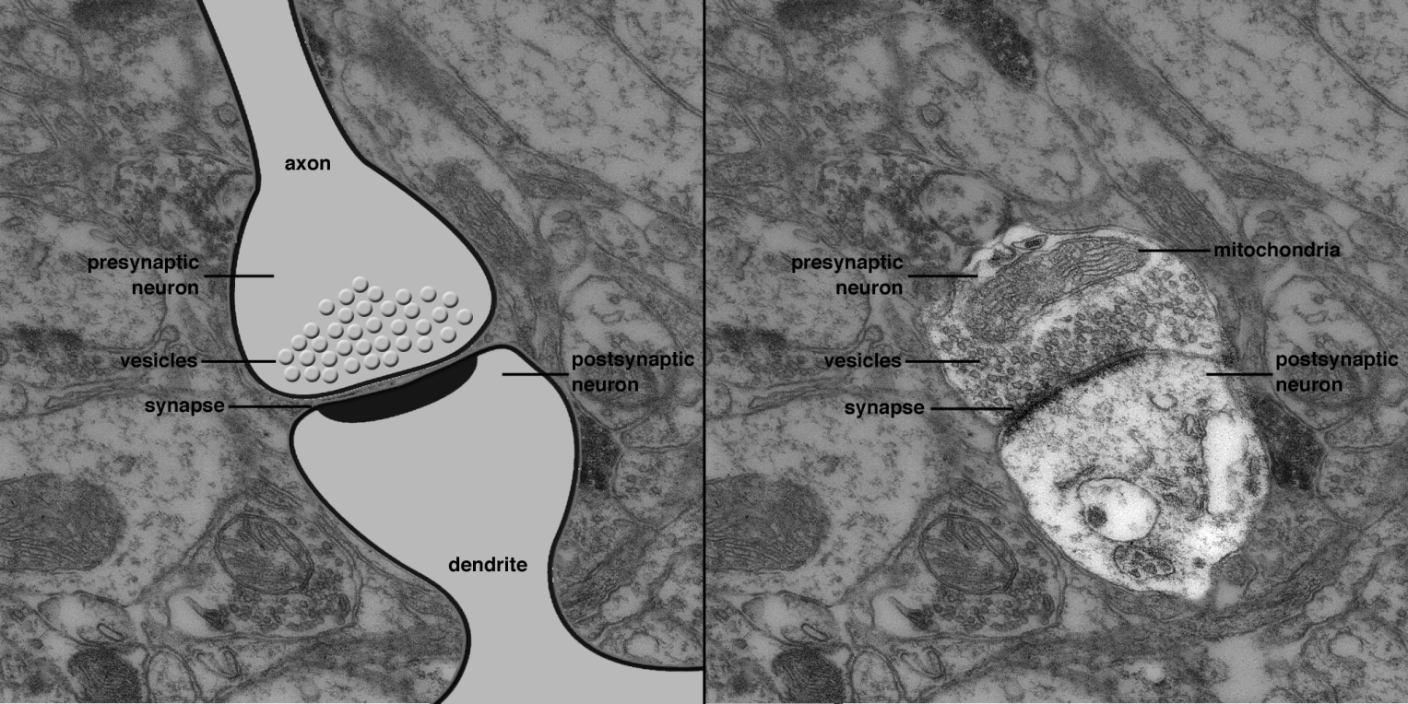
Synapse
Electron Microscopy photograph of synapse

Slide 10
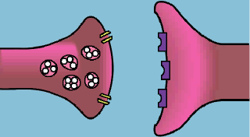
Synaptic transmission

Slide 11
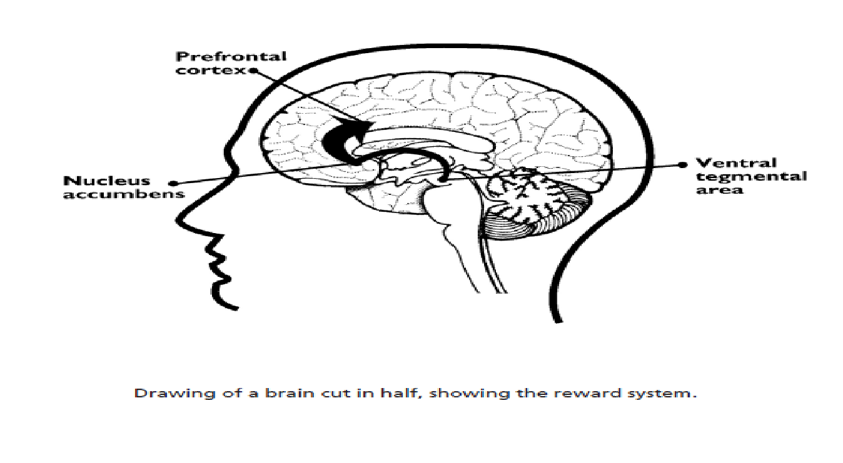
Human brain – reward system

Slide 12
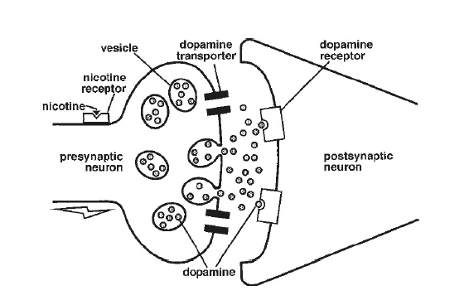
This is your brain on drugs

Slide 13
Addiction
Drug addiction is defined as the continued compulsive use of drugs despite adverse health or social consequences. Drug-addicted people have lost control of their drug use. Individuals who are addicted to drugs often become isolated from family or friends, have difficulty at work or school, may commit crimes, and become involved with the criminal justice system. For a person addicted to drugs, continuing to take them becomes the primary focus in life.

Slide 14
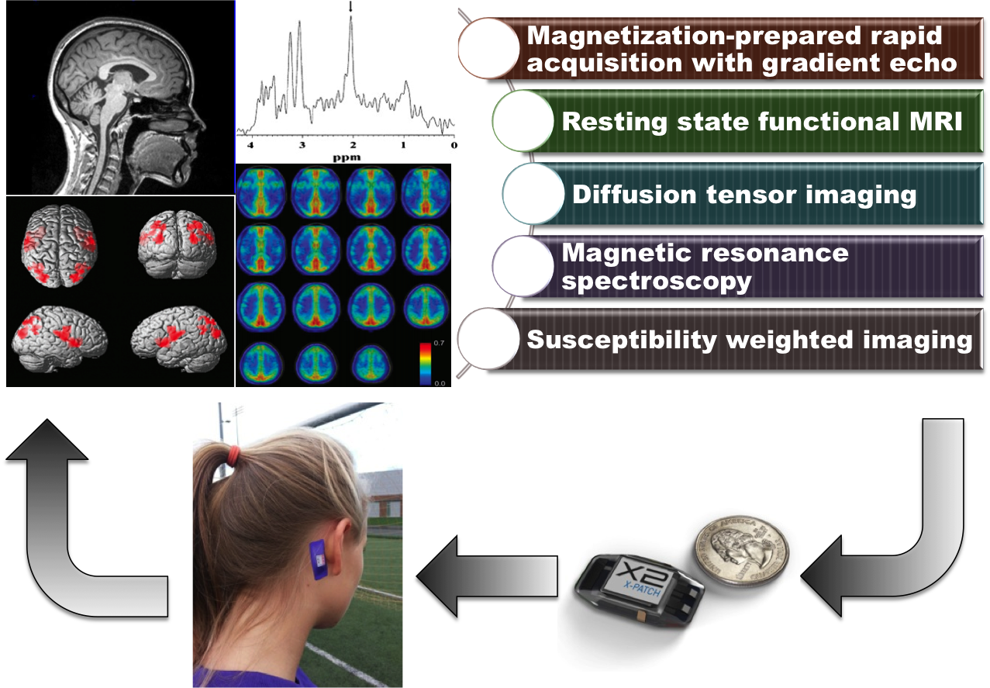
Concussions and Head Impact

Slide 15
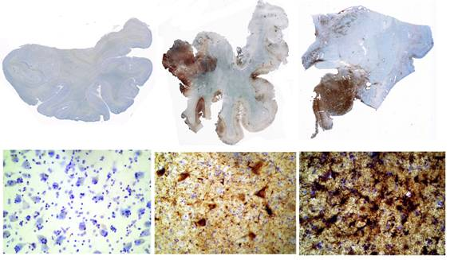
Chronic Traumatic Encephalopathy
Chronic Traumatic Encephalopathy (CTE) is a progressive degenerative disease (Tauopathy)
CTE is primarily found in athletes/military with a history of repetitive brain trauma
CTE has been known to affect boxers since the 1920s
Boston University Center for the Study of Chronic Traumatic Encephalopathy

Slide 16
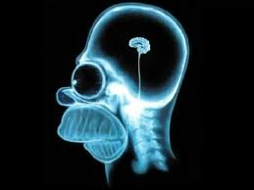
Questions?

